Slide 1
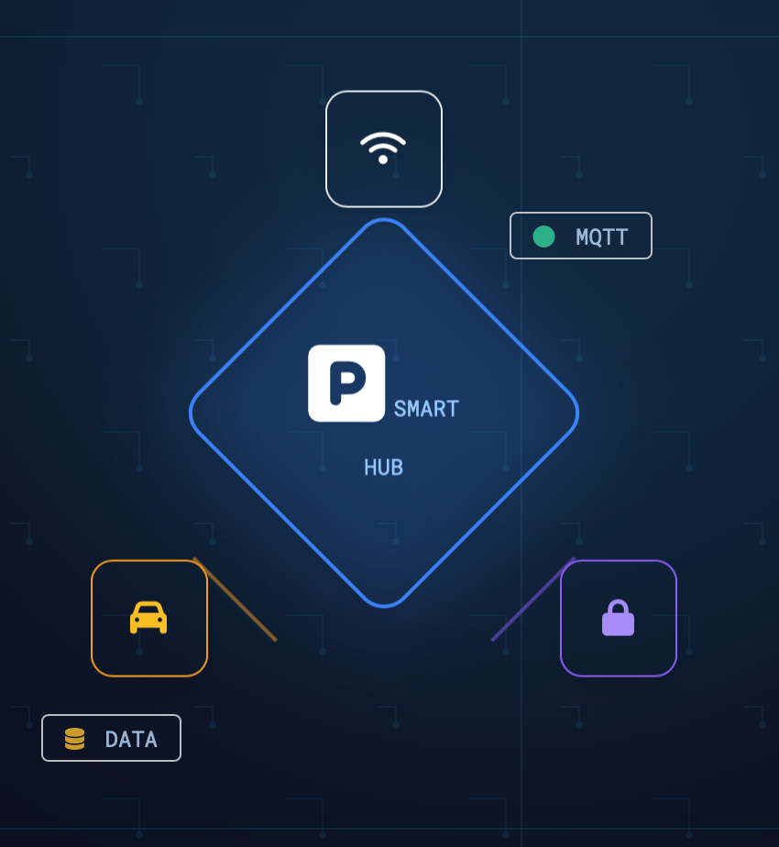
Smart Parking
Reservation System
End-to-end IoT system with simulated gateways & locks, MQTT middleware
and real-time monitoring dashboard
Course: INTERNET OF THINGS
Developed By: Sepideh Mottaghi(S5003374)
Forough Majidi(S5475593)
Date: January 2026

Slide 2


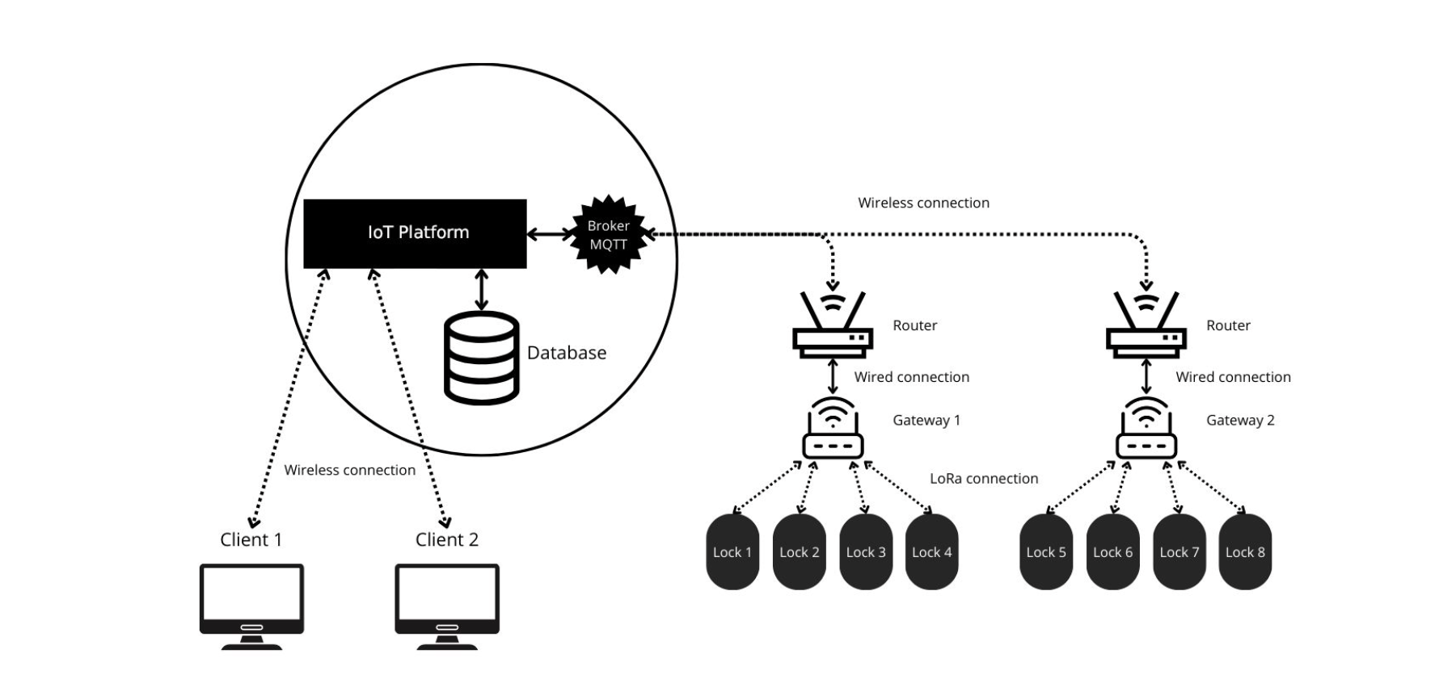
Reference Architecture & Implementation Mapping
1. Client Layer
Firebase (Google Cloud managed services)
Next.js
Firestore Database
Firebase Authentication Service
2. IoT Platform
Node-Red
Scalable
Reliable
Interoperable
3. Communication Middleware
MQTT with Mosquitto
Reference Architecture
4. Simulated Devices
Node.js
Gateways
Locks

Slide 3
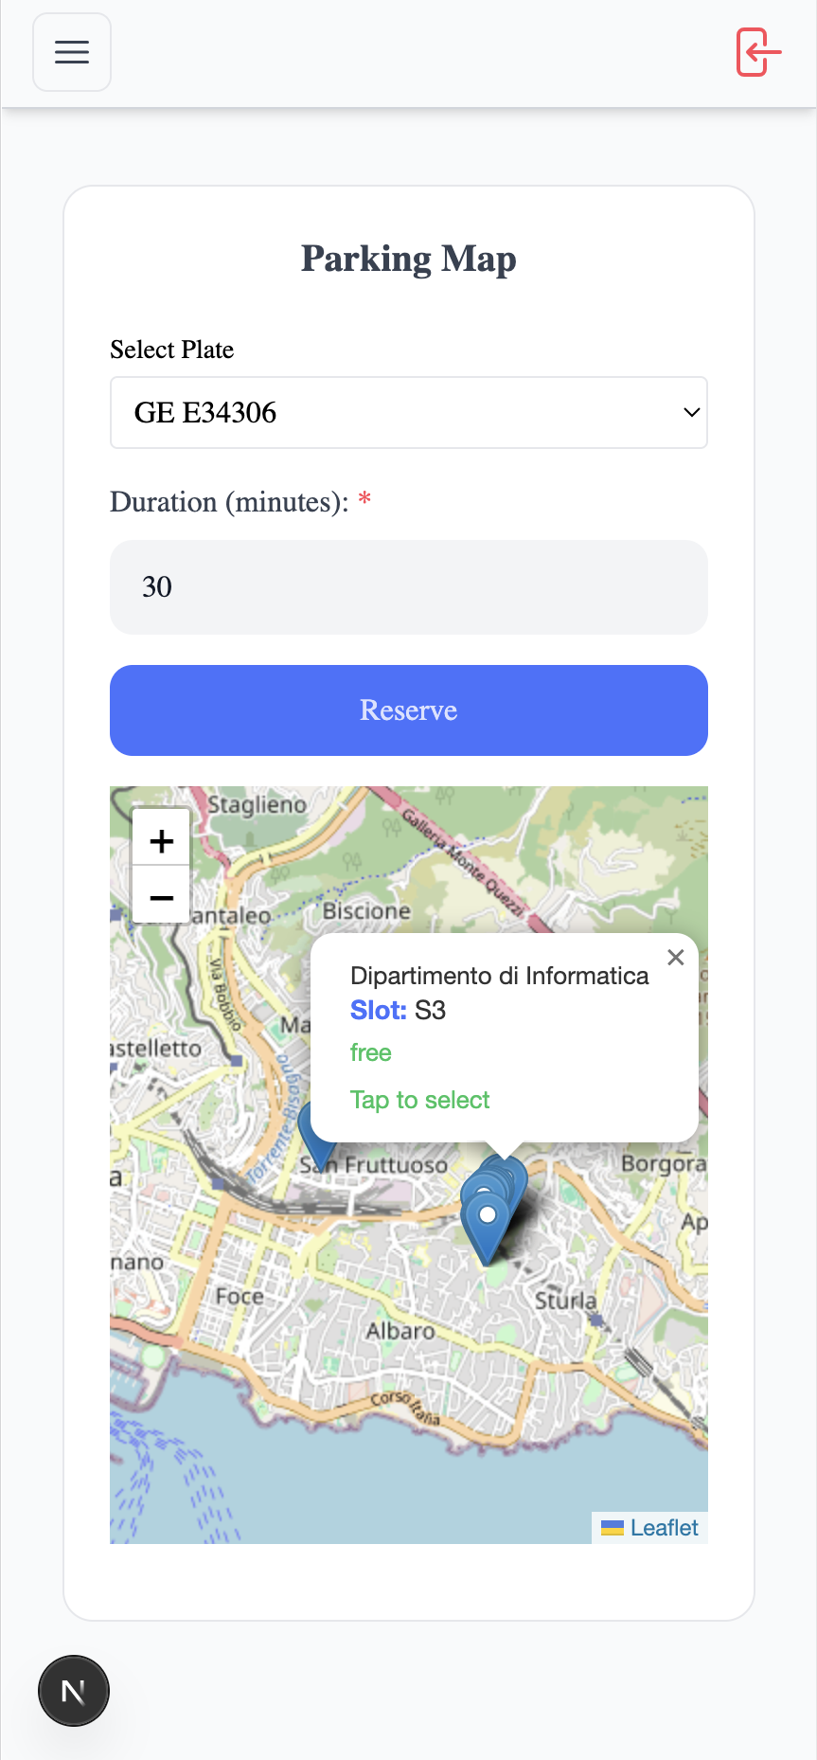
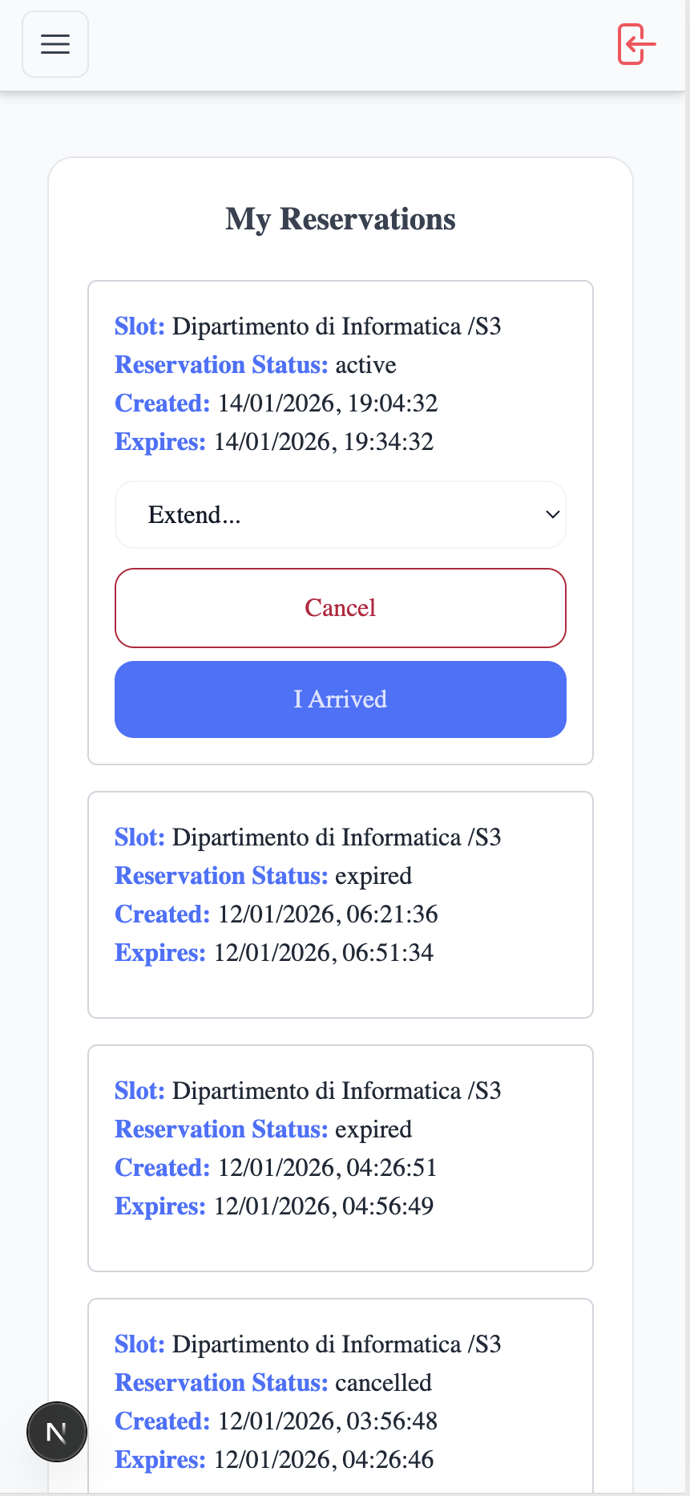
Client Layer: User-Centric Web Application
User Capabilities:
Secure authentication and profile management.
Real-time visualization of parking slots on an interactive map.
Effortless reservation process, including plate number and duration selection.
Comprehensive reservation management: arrive, extend, cancel, and leave.
The client never talks directly to IoT devices. All interactions go through the IoT platform via HTTP(REST) APIs
Examples:
POST /reservations
POST /reservations/{id}/arrive
POST /reservations/{id}/leave
Key Technologies:
Next.js
React
React-Leaflet & Leaflet
Firebase Authentication
Firestore SDK.
Browser Geolocation API

Slide 4
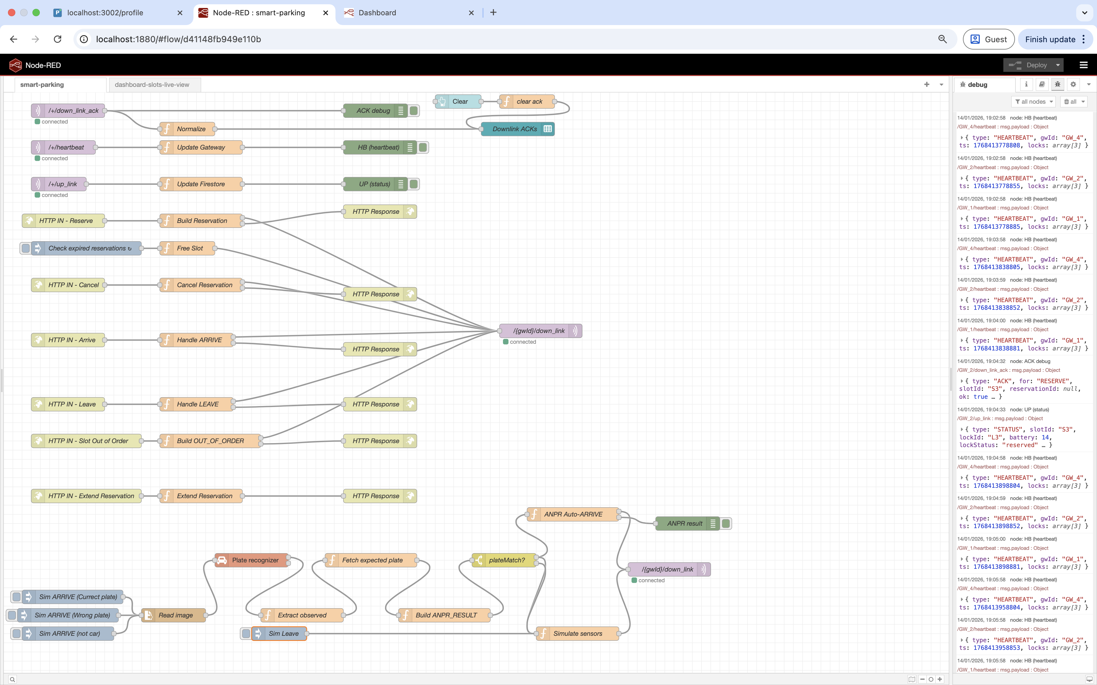
IoT Platform: Node-RED for Orchestration
Serves as the central orchestration and control hub for the entire smart parking system
Integrated Protocols
Visualized Flows
Event-Driven Logic
Responsible for:
validating reservation requests,
managing the full reservation lifecycle,
publishing commands to gateways via MQTT,
processing device status and heartbeat messages,
updating persistent data storage,
feeding critical data to the monitoring dashboard.
Building Blocks of Logic:
HTTP In / HTTP Response
MQTT In / MQTT Out
Function Nodes
Inject & Switch Nodes

Slide 5
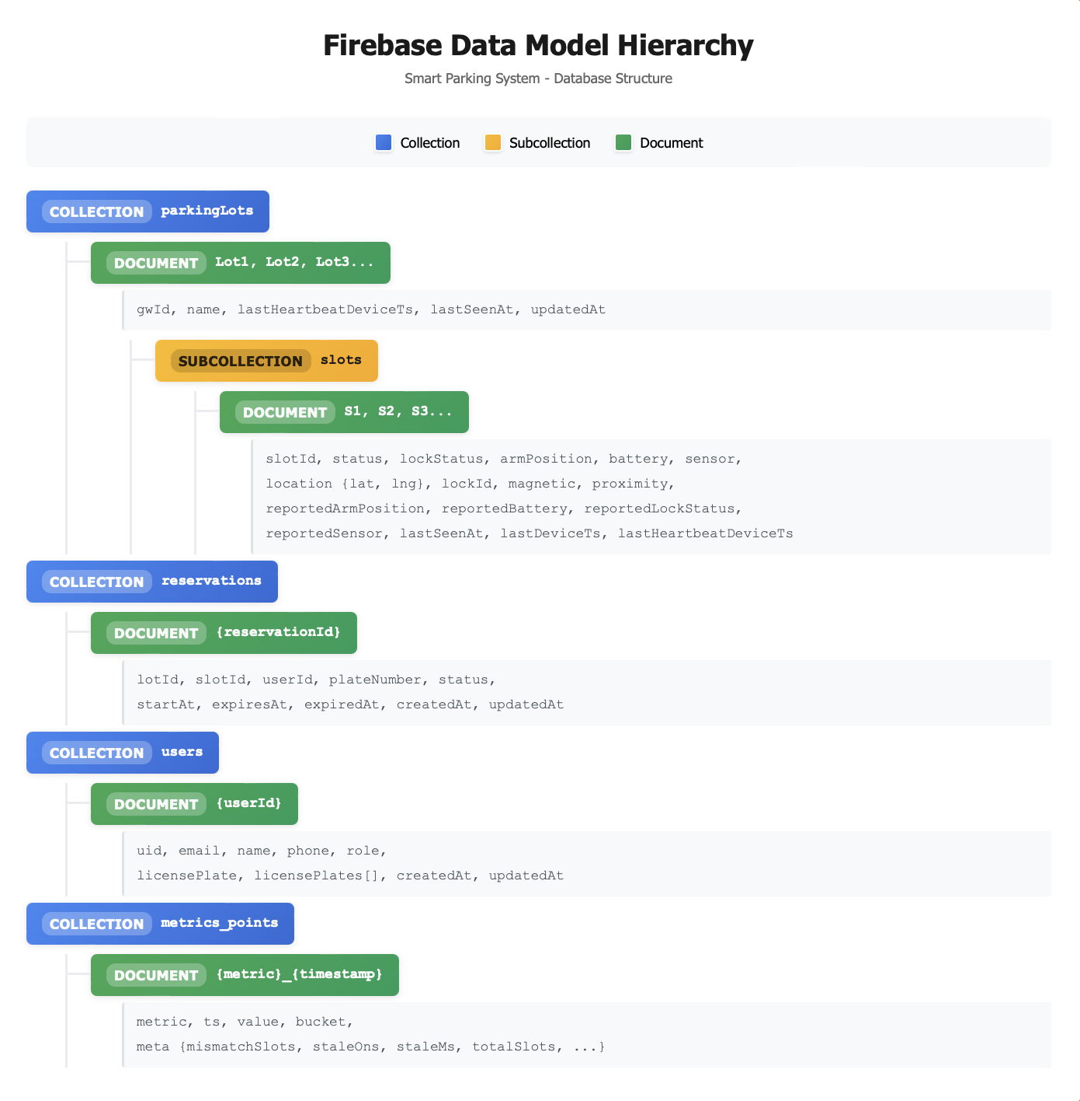
Persistent Data Model (Firestore)
Hierarchical NoSQL schema for real-time IoT state
Hierarchical model mirrors physical deployment
Separation of concerns: physical state vs. business logic
Optimized for real-time updates
Transaction-safe lifecycle updates
Supports monitoring and analytics
Scales naturally with number of lots and devices

Slide 6
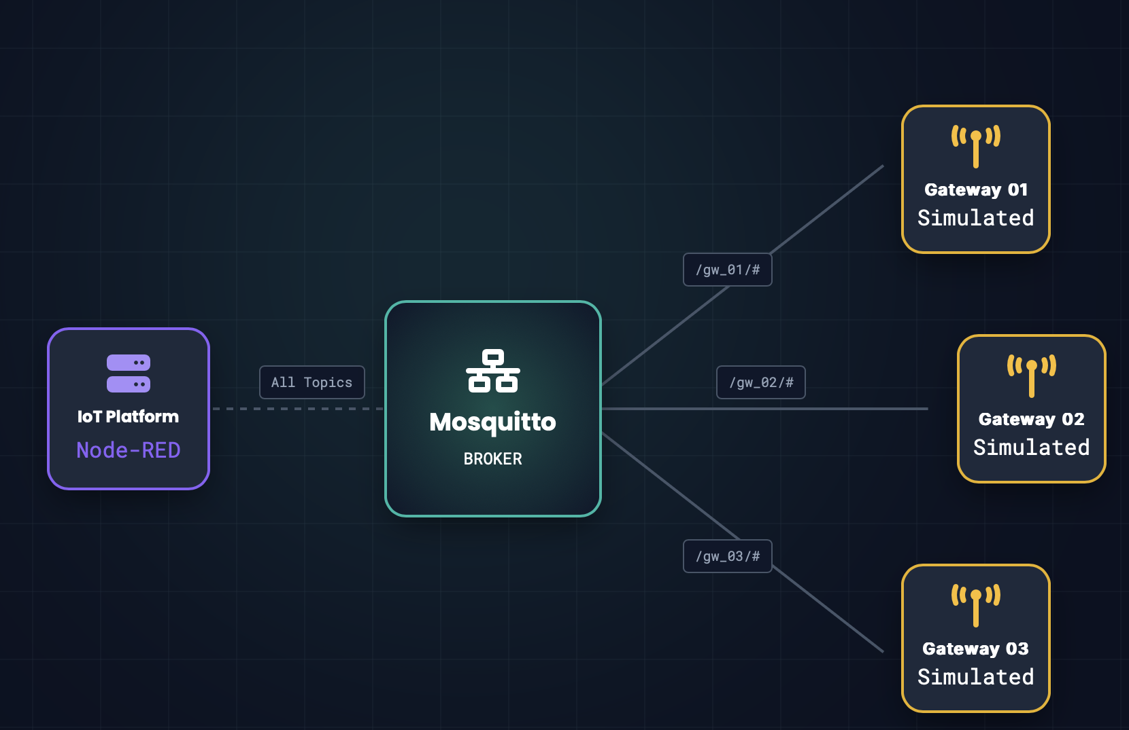
Communication Middleware: MQTT with Mosquitto
Mosquitto Broker Configuration:
Standard MQTT Port (1883): Operating over TCP/IP
Message Format: All MQTT messages are encoded in JSON.
Key MQTT Topics:
/gwId/down_link: Commands from the platform to specific gateways.
/gwId/down_link_ack: Acknowledgement from gateways to the platform.
/gwId/up_link: Status updates originating from locks, forwarded by gateways to the platform.
/gwId/heartbeat: Periodic health messages of gateways and their related locks from gateways to the platform.
Gateway ↔ Lock radio link (LoRaWAN / RF) - Simulation
Internal Gateway–Lock Topics:
/gwId/lockId/cmd: commands from gateway to lock
/gwId/lockId/status: status updates from lock to gateway
/gwId/lockId /heartbeat: periodic lock health messages
The same communication middleware
internally between gateways and their related locks

Slide 7
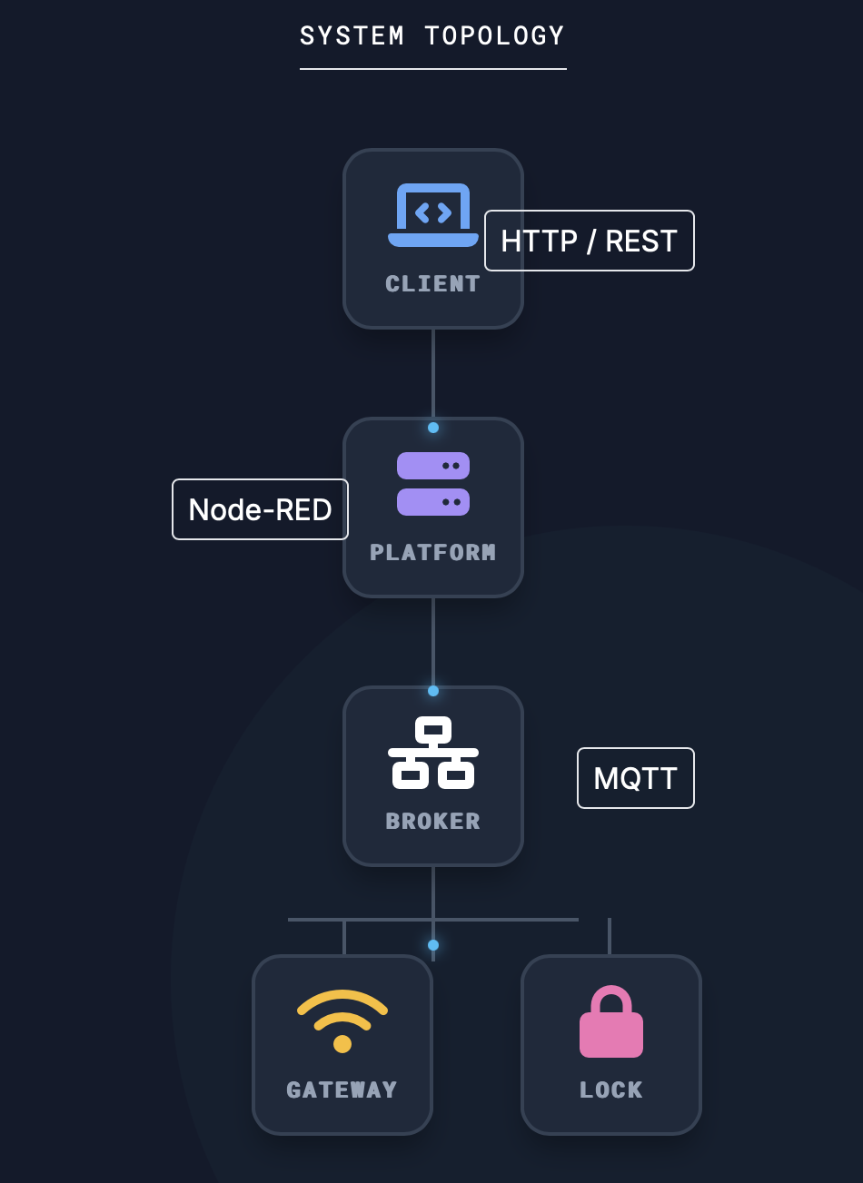
Simulated Devices: Gateways and Locks
To faithfully replicate a real IoT deployment without physical hardware, both gateways and locks are simulated using Node.js.
Gateway Simulation:
Each represent a single gateway installed on a lot and manage all the locks
Connects to Mosquitto as an MQTT client.
Subscribes to its dedicated down_link topic for incoming message.
Acts as bridge, translating platform-level topics (/+/down_link) into per-lock internal topics.
Publishes acknowledgements (down_link_ack) to IoT platform.
Aggregates messages & publishes periodic heartbeat messages.
Lock Simulation:
Simulated Devices & Execution
Gateways and locks run as independent Node.js processes..
Each represents a lock installed on a slot, maintaining internal state (status, arm position, battery, sensors states).
Subscribes to commands forwarded by its gateway.
Updates its internal status in response to received commands (e.g., raising/lowering arm) and publishes Status messages.
Periodically publishes heartbeat messages to its gateway.
Simulates real-world conditions like battery drain and dynamic sensor changes.

Slide 8
Reservation Lifecycle
Reserving
Reserved
Extend
Expiration Enforcement:
Periodic Node-RED job
Every 60 seconds it checks Firestore for active or occupied reservations that have passed expiresAt
Atomically set slot status to free and reservation to expired in Firestore
send an MQTT EXPIRED message to the gateway(down_link)
Free
Expire
Cancel
Occupied
Completed
Leave simulation:
In a real deployment, a user does not click “I left”
In Node-RED, leave is simulated by removing physical presence, both magnetic and proximity sensors transition to false.
Publish a MQTT "SIM_OBJECT” message to the gateway(down_link)
Alice Use Case Coverage
End-to-End Request Flow: From Client to Device
Full lifecycle of a reservation command from user click to physical actuation
Client App
User clicks
"Reserve".
Sends HTTP POST.
loT Platform
Validates, creates
”Reserving” record in DB.
loT Platform
publishes a downLink to the gateway via MQTT.
Gateway
Routes message to specific Lock. Sends ACK.
Lock Device
Arm raises. status changed.
Publishes Status.
Gateway
Return Lock STATUS to IOT platform via UpLink
loT Platform
Receives
STATUS. Updates
DB record to Reserved
Client App
Firestore Listener triggers. UI update: Slot turns Occupied on Map.

Slide 9



Improvements Implemented
Simulated Camera & external ANPR service uses image input to compare observed plate with expected plate, enabling automatic arrival confirmation upon a match.
Test cases: correct plate, wrong plate.
Utilizes the browser's Geolocation API to verify physical presence near the parking slot to automatically trigger arrival .
A cost-effective alternative to camera-based solutions.
Magnetic sensor is combined with proximity sensor to detect mismatches and abnormal conditions, enhancing accuracy through sensor fusion.
Test cases: correct/wrong plate, non-car object (magnetic-only)
ANPR-Based Arrival
GPS-Based Arrival
Proximity Sensor

Slide 10
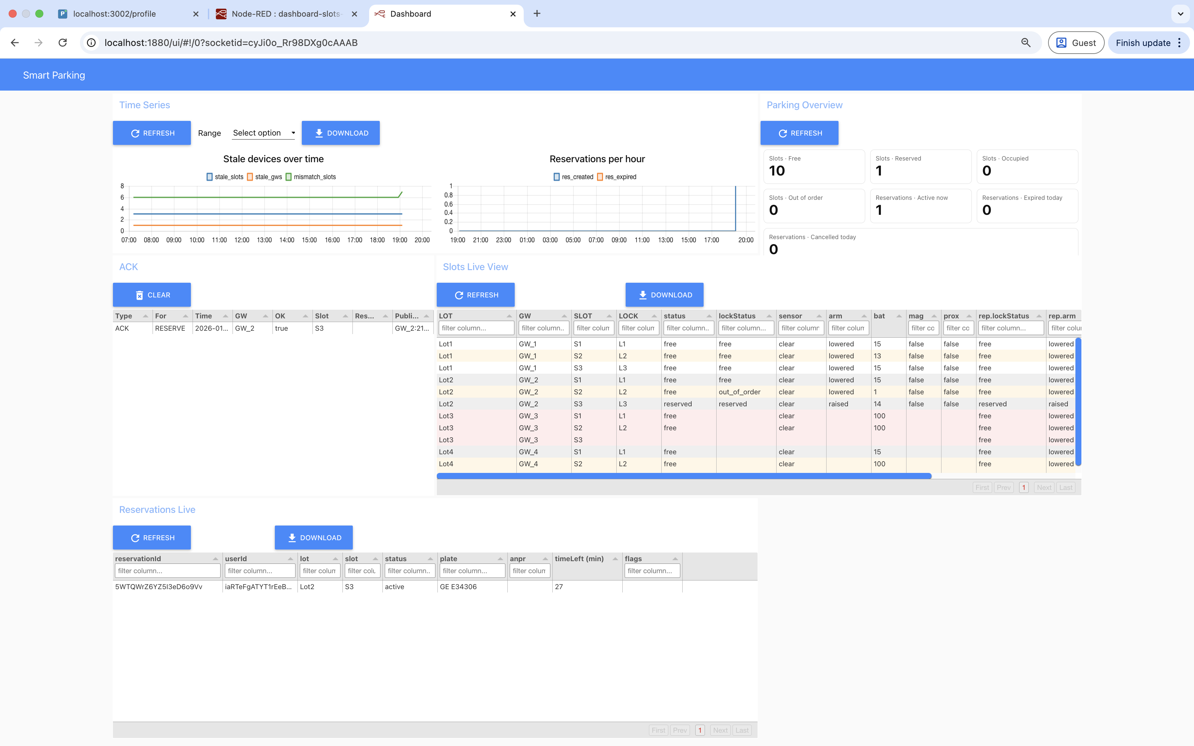
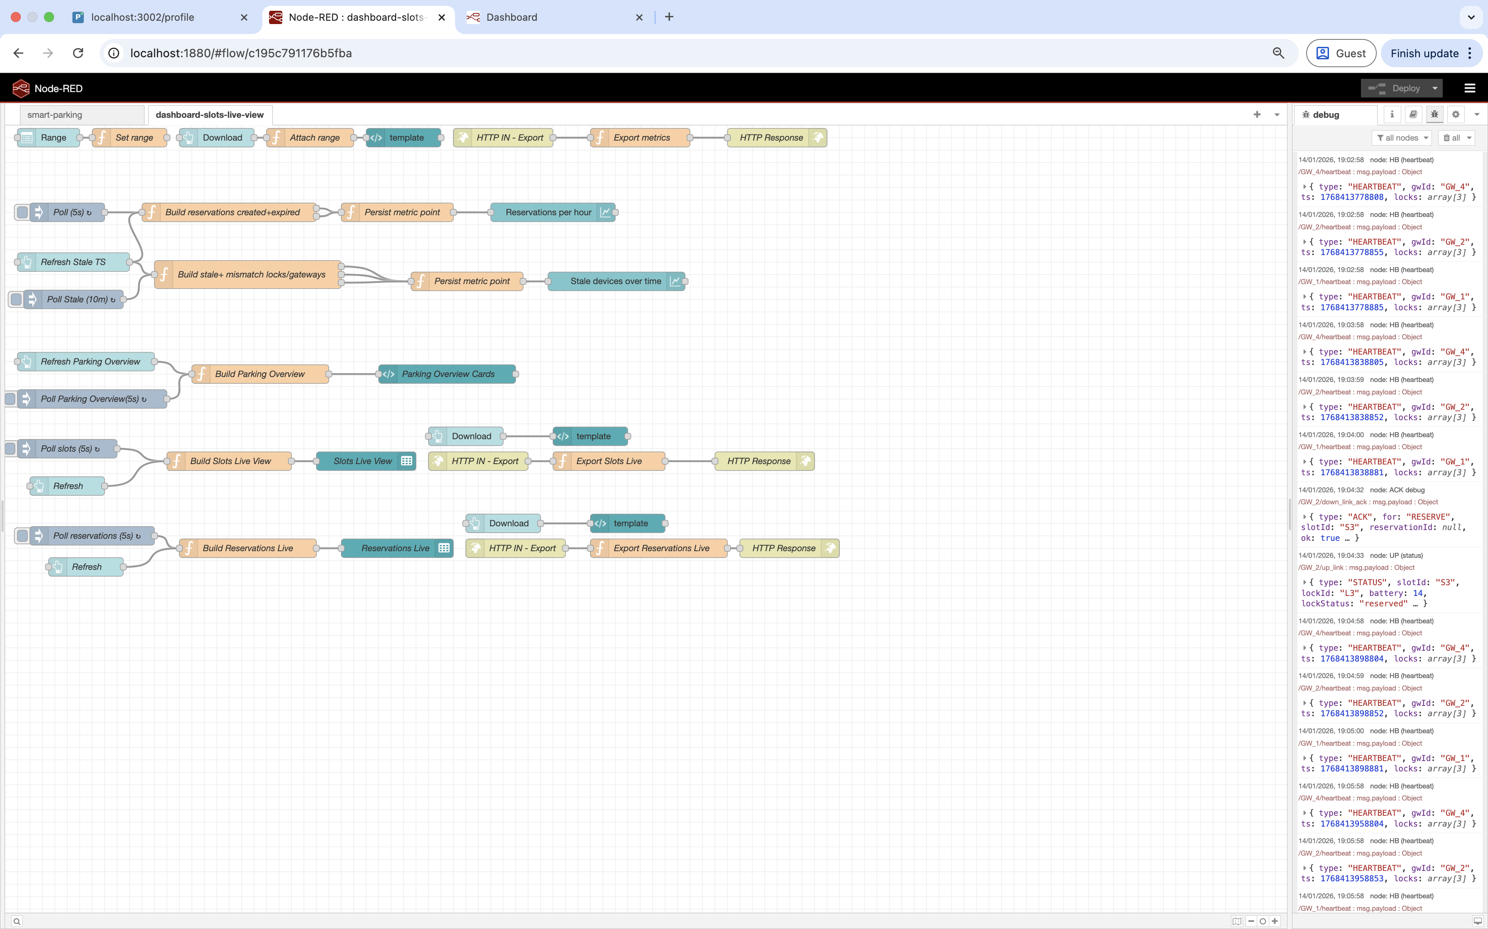
Dashboard & Data Series: Real-time system health, reservation metrics, and data export
A comprehensive dashboard is integrated into the system, fulfilling the requirement for storing, visualizing, and exporting critical data series.
This provides administrators and operators with deep insights into system performance and real-time operational status.
Live Views:
Slots Live View: Merges logical reservation status with physical device statuses, displaying lock status, battery levels, last heartbeats, and highlighting stale or mismatched devices.
Reservations Live View: Shows all active and occupied reservations, including remaining time and flags for expiring or expired reservations.
Parking overview:
Counters for free, reserved, and occupied slots.
Identification of out-of-order devices.
Metrics for active/expired/cancel reservations.
Time-Series Metrics:
Tracking the number of stale/mismatch devices over time.
Analysis of reservations created per hour/day.
Monitoring of reservations expired per hour/day.
JSON Export Functionality:
Enables export of slots live data, reservations live data, and time-series metrics for external analysis and reporting.
Includes live operational signals (acknowledgements)

Slide 11
Conclusion
System Deliverables
Functional outcomes
Responsive web app with real-time map + reservation management
End-to-end reservation lifecycle (reserve / arrive / extend / cancel / leave / expire)
﻿﻿Real-time dashboard + analytics + JSON export
Hardware-Ready Architecture
Future Roadmap
Requirements for production deployment.
Security Hardening: Implement TLS encryption for MQTT and robust device authentication certificates.
Physical Integration: Replace simulated Node.js locks and Gateway with real hardware.
ANPR Expansion: Deploy real camera hardware.
Sensor Calibration & Fusion: Calibration of magnetic and proximity sensors per slot.
Resilience & Reliability: Offline buffering, MQTT QoS, retries, and fault recovery.
Core Architecture Preserved
Simulation
Full loT layered architecture implemented
﻿﻿Correct usage of protocols (MQTT, HTTP/REST)
﻿﻿Realistic message flows & asynchronous behaviour
﻿﻿Distance-based proximity sensing modelled (threshold-based) and fused with magnetic detection

